Slide 1


Team InSight
Vision for Blind
Team Members:
Priyansh Sharma Pratham Pahariya Ishal Garg
Aditya Kumar Garg Bhavesh Sharma
01

Slide 2
IT IS ESTIMATED THAT AROUND 285 MILLION PEOPLE IN THE WORLD ARE VISUALLY IMPAIRED.
PROBLEMS FACED BY VISUALLY IMPAIRED PEOPLE
THEY ARE PRONE TO ROAD ACCIDENTS AND ARE NOT AWARE OF ANY DANGER AROUND THEM.
THEY ARE NOT ABLE TO READ & UNDERSTAND ANY TYPE OF WRITTEN TEXT, BILL, CURRENCY DENOMINATION.
THEY ALSO FACE DIFFICULTIES IN REACHING THEIR DESTINATION PROPERLY AND AT TIMES THEY DETOUR FROM THEIR ACTUAL PATH.
02

Slide 3
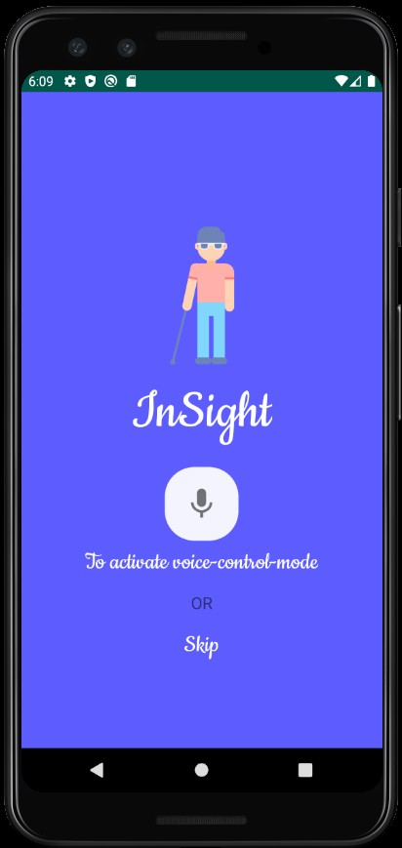

Introducing InSight
SINCE THE PROBLEMS FACED BY VISUALLY IMPAIRED PEOPLE ARE NUMEROUS AND MOST CURRENT AVAILABLE SOLUTIONS ARE EITHER TOO OBSOLETE OR TOO EXPENSIVE TO ADOPT.
SMART AI-BASED SOLUTIONS TO HELP VISUALLY IMPAIRED PEOPLE LEAD NORMAL LIVES WITHOUT SPENDING MUCH MONEY.
03

Slide 4
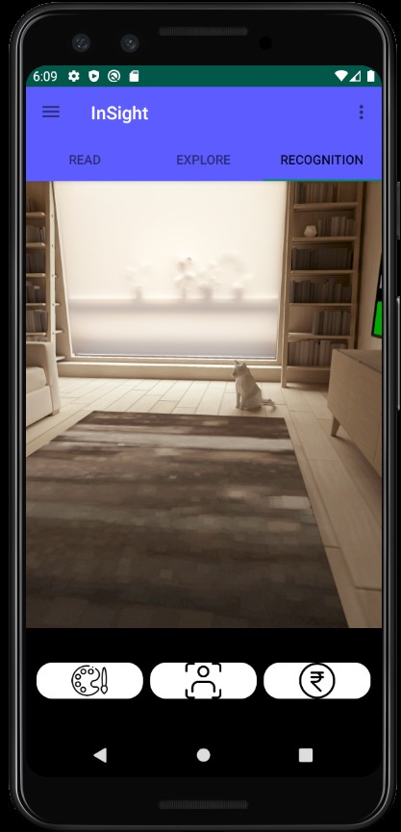

The Idea
Visual Support Glasses synced with a mobile application that will help visually impaired people live a better life
Convert real time images to easy to understand audio format.
Voice-controlled commands for easy accessibility.
04

Slide 5

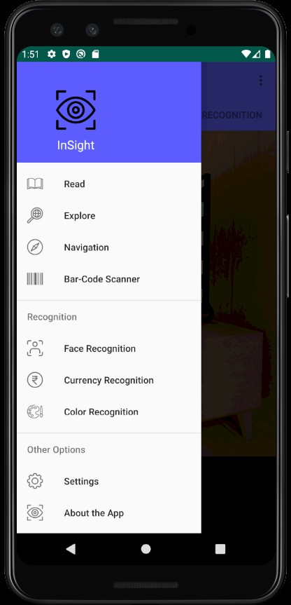







Features:
Object Recognition
Facial Characteristics Recognition
Currency Recognition
Safe Navigation
Text Recognition
Color Recognition
05

Slide 6
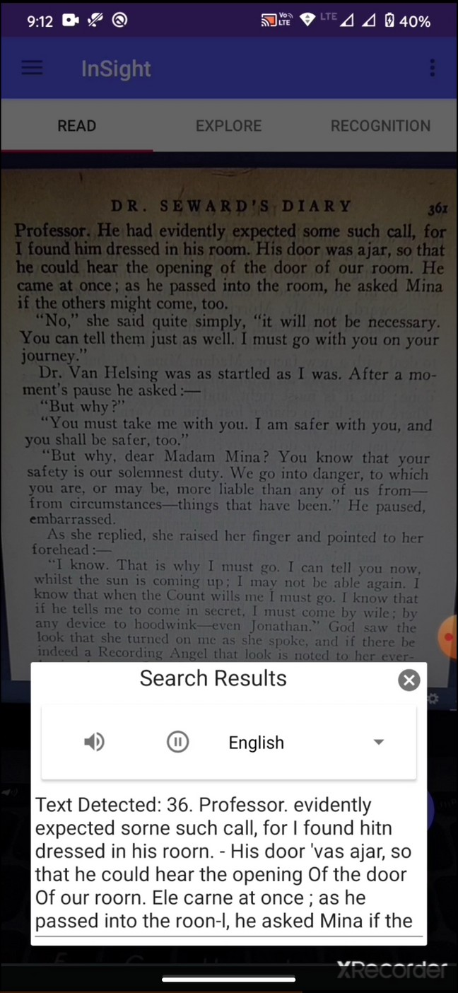

Tech Stack
COMPUTER LANGUAGE:
Python(for deep learning) and Java (for android application).
DEEP LEARNING FRAMEWORK:
PyTorch/Tensorflow
IMAGE PROCESSING LIBRARY:
OpenCV
ANDROID DEVELOPMENT IDE:
Android Studio
OTHERS:
Google Text to Speech and Speech to Text, Solidworks, Microsoft CV API, Microsoft Face API.
06

Slide 7
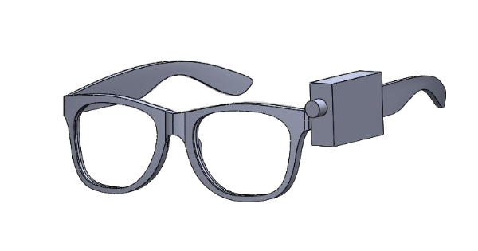

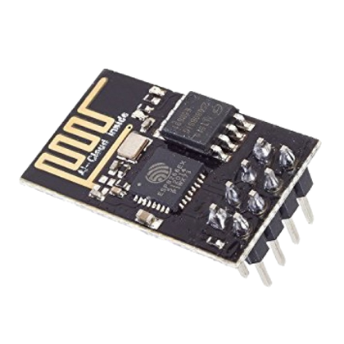
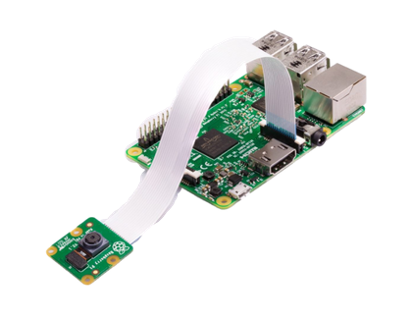
Hardware Integration
Raspberry Pi
Raspberry Pi Camera Module ESP8266
Haptic Motor
Raspberry Pi Night Vision Camera
Microphone speaker Haptic Motor Ultrasonic sensor GPS module
Camera module
ESP 8266
07

Slide 8
R e v e n u e M o d e l
Features
MOBILE APP
FREE
BASIC
₹4000
HOUSEHOLD
₹5000
NAVIGATION
₹10,000
OPTICAL CHARACTER RECOGNITION
OBJECT DETCTION
COLOUR RECOGNITION
CURRENCY RECOGNITION
FACIAL EXPRESSION RECOGNITION
SAFE NAVIGATION
HARDWARE PRODUCT
HAPTIC RESPONSE
SPEAKER ASSIST
CLOUD STORAGE
INSIGHT STICK
LIVE CAMERA
08

Slide 9








Easy Detection
FUTURE DEVELOPMENT AND ADDITION
A feature that will focus on the particular part of the image where the user is interested through pointing a finger, etc. Also, store familiar faces and inform when the same person revisits.
Hearing Disability
Speaking Disability
A feature that will convert the voice of some other person into text which can be easily read and understood by a person with hearing disability.
A feature that will detect the sign language of the person with speaking disability through the camera and then convert it to text or speech so that it can be easily understood by some other person who doesn’t understand sign language.
09

Slide 10
THANK YOU!
Team InSight
10

